Slide 1
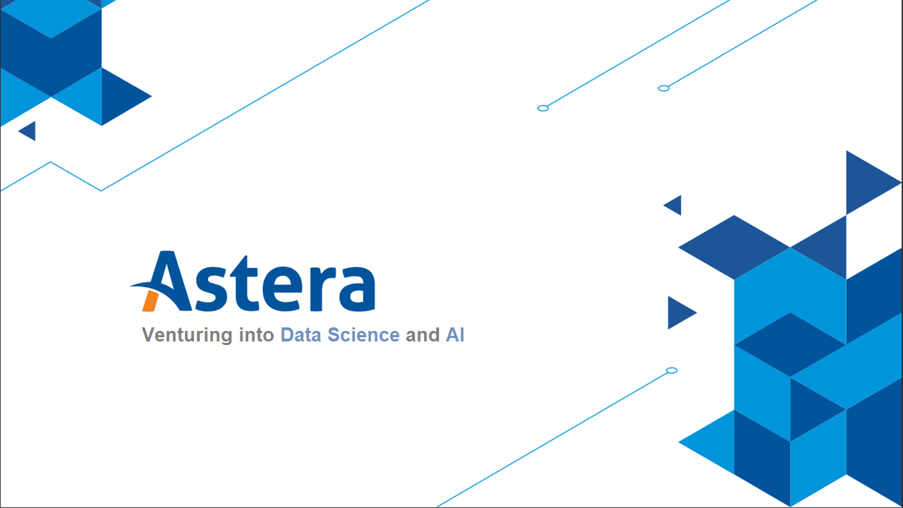

Slide 2

Topics
Understanding Unsupervised Learning
Hidden Patterns using ML
Associate Rule-Based mining in the retail industry
Clustering Basics
K-Means
Elbow Analysis
Cluster Validation – Silhouette Coefficient

Slide 3
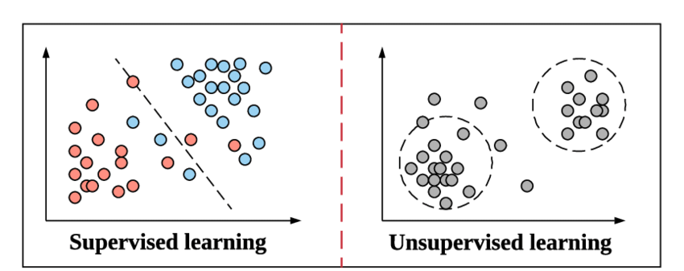
Recap: Supervised and Unsupervised Learning

Slide 4
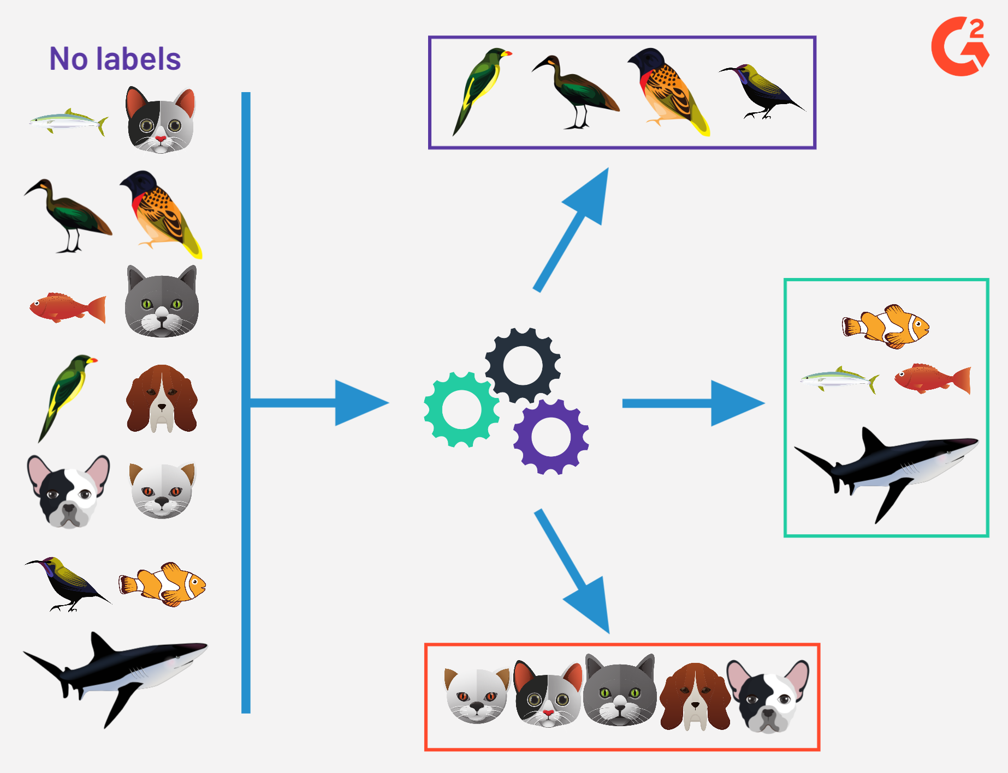
Understanding Unsupervised Learning
Unsupervised machine learning involves using algorithms to analyze and group unlabeled datasets without human intervention. It is useful for discovering hidden patterns and similarities in data, making it ideal for tasks such as exploratory data analysis, customer segmentation, and image recognition.

Slide 5
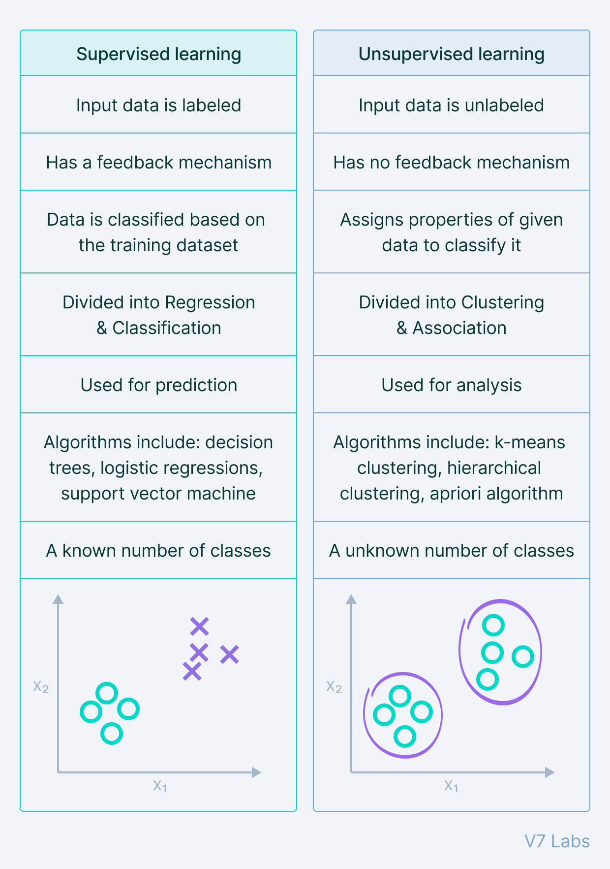
Supervised vs Unsupervised Learning

Slide 6
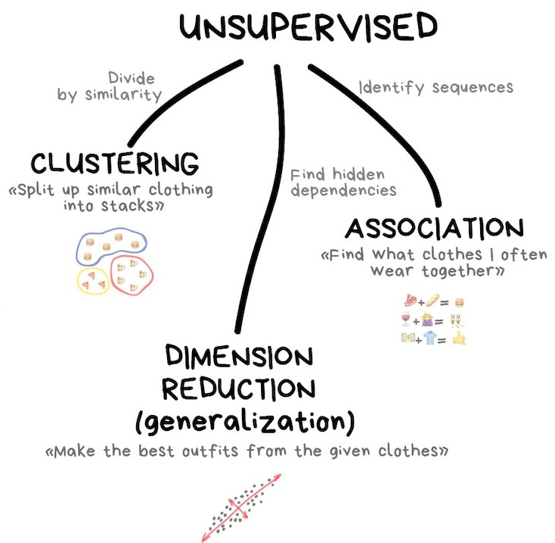
Hidden Patterns Using ML
A pattern is some phenomenon that repeats regularly based on a set rule or condition.
Pattern recognition requires the repetition of experience. They are important when making comparisons, judgments, and acquiring knowledge.
A machine learning algorithm is written to derive the model. The model identifies the patterns in data that fit the dataset. Fit is a synonym to “find patterns in data”
Notes:
Humans and animals learn with the help of the senses. Learning helps in identifying and recognizing patterns around us. The process of pattern recognition involves matching the information received with the information already stored in the brain. Making the connection between memories and information perceived is a step of pattern recognition called identification.

Slide 7
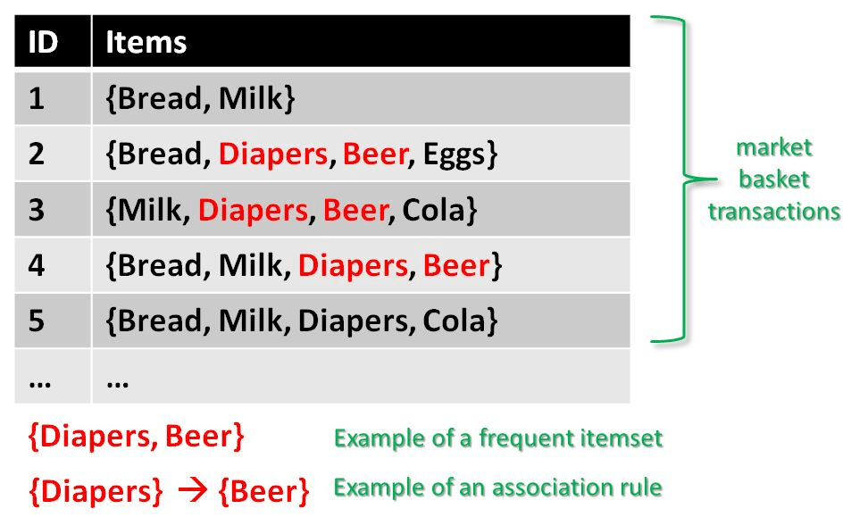
Association Rule-Based Mining in the Retail Industry
Association Rule Mining is used when you want to find an association between different objects in a set, and find frequent patterns in a transaction database, relational databases, or any other information repository.
Market Basket Analysis uses Association Rule Mining to derive rules from the Shopping Basket (Transactions).
Notes:
Given is a set of transaction data. You can see transactions numbered 1 to 5. Each transaction shows items bought in that transaction. You can see that Diaper is bought with Beer in three transactions. Similarly, Bread is bought with milk in three transactions making them both frequent item sets.

Slide 8
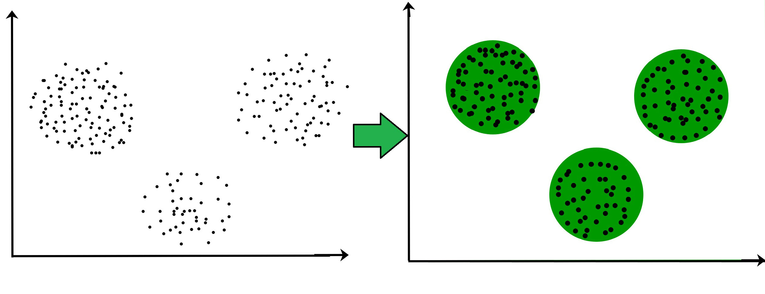
Clustering Basics
Clustering is the task of dividing the population or data points into several groups such that data points in the same groups are more similar to other data points in the same group and dissimilar to the data points in other groups.
It is basically a collection of objects based on similarities and dissimilarities between them

Slide 9
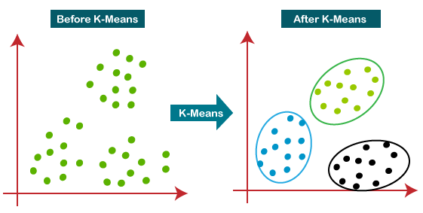
K-Means Clustering
K-Means Clustering is an Unsupervised Learning algorithm, which groups the unlabeled dataset into different clusters. Here K defines the number of pre-defined clusters that need to be created in the process, as if K=2, there will be two clusters, and for K=3, there will be three clusters, and so on.
K = 3

Slide 10
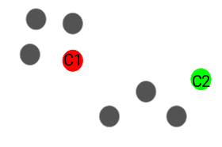
Applying K-Means Clustering
Step 1: Choose the number of clusters K: The first step in k-means is to pick the number of clusters, K = 2.
Step 2: Select k random points from the data as centroids: Next, we randomly select the centroid for each cluster. Let’s say we want to have 2 clusters, so k is equal to 2 here. We then randomly select the centroid.
Here, the red and green circles represent the centroid for these clusters.
K = 2

Slide 11
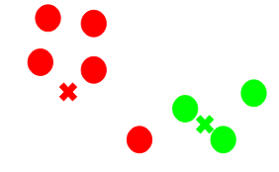
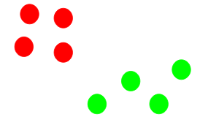
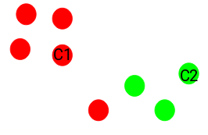
Applying K-Means Clustering
Step 3: Assign all the points to the closest cluster centroid: Once we have initialized the centroids, we assign each point to the closest cluster centroid.
Here you can see that the points closer to the red point are assigned to the red cluster, whereas the points closer to the green point are assigned to the green cluster.
Step 4: Recompute the centroids of newly formed clusters: Now, once we have assigned all of the points to either cluster, the next step is to compute the centroids of newly formed clusters.
Here, the red and green crosses are the new centroids.
Step 5: Repeat steps 3 and 4: We then repeat steps 3 and 4
The step of computing the centroid and assigning all the points to the cluster based on their distance from the centroid is a single iteration. But wait – when should we stop this process? It can’t run till eternity, right?
K = 2
K = 2
Notes:
Stopping Criteria for K-Means Clustering
There are essentially three stopping criteria that can be adopted to stop the K-means algorithm:
Centroids of newly formed clusters do not change
Points remain in the same cluster
Maximum number of iterations is reached

Slide 12
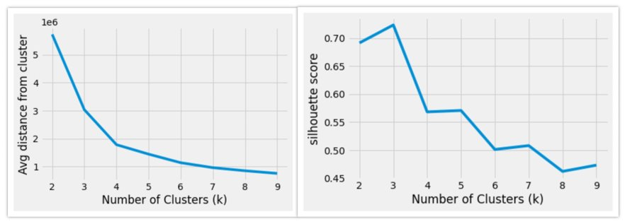
Clustering Evaluation Method
WSS: Sum of Squares Within Clusters
Cohesion: Differentiation Within Clusters
BSS: Sum of Squares Across Clusters
Separation: Differentiation Across Clusters

Slide 13
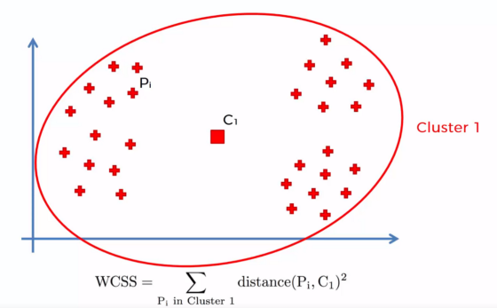
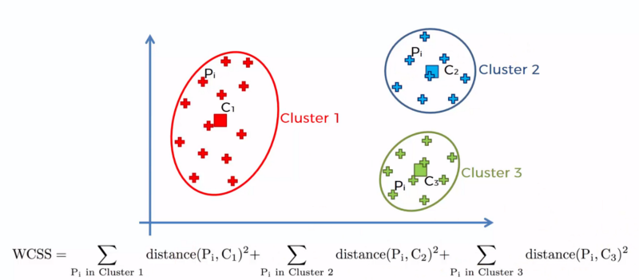
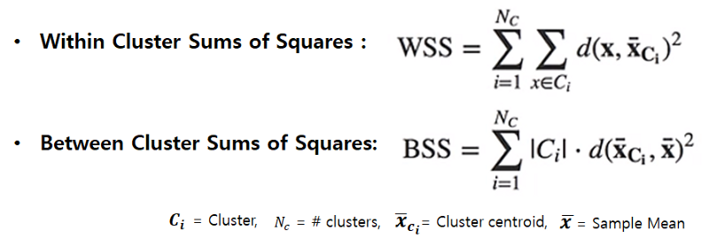
Clustering Evaluation Method

Slide 14
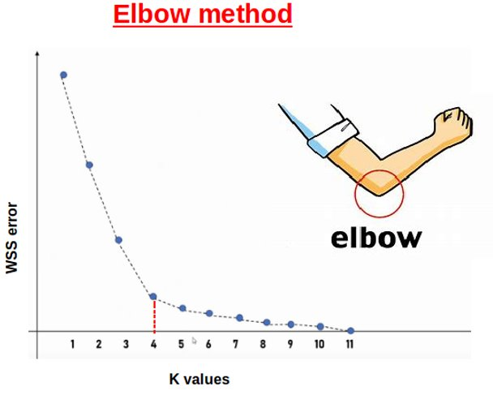
How to Choose K: Elbow Method
Notes:
The elbow method is a graphical representation of finding the optimal 'K' in a K-means clustering.

Slide 15
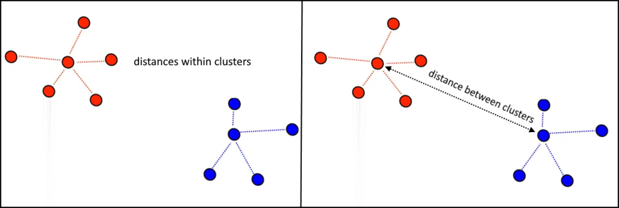

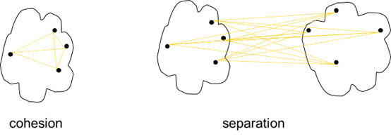
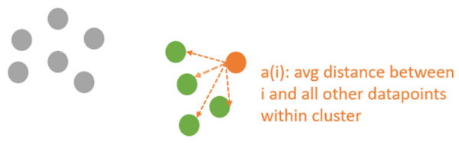
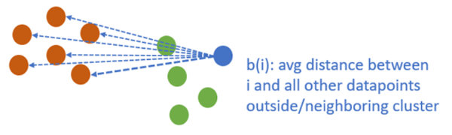
How to Choose K: Silhouette Method
The silhouette coefficient or silhouette score kmeans is a measure of how similar a data point is within-cluster (cohesion) compared to other clusters (separation).
The equation for calculating the silhouette coefﬁcient for a particular data point:
S(i) is the silhouette coefficient of the data point i.
a(i) is the average distance between i and all the other data points in the cluster to which i belongs.
b(i) is the average distance from i to all clusters to which i does not belong.
Notes:
The range of the Silhouette value is between +1 and -1. A high value is desirable and indicates that the point is placed in the correct cluster. If many points have a negative Silhouette value, it may indicate that we have created too many or too few clusters.

Slide 16
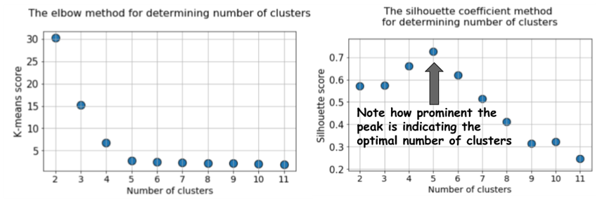
Elbow vs Silhouette

Slide 17
Limitations of K-Means Clustering
One limitation of the k-means algorithm we should acknowledge is that it requires the data to be numerical.
Categorical variables such as gender are meaningless to k-means. What is the mean of a group of males and females? Can we still cluster data that is partly or even fully categorical?
Notes:
A solution for fully categorical data is known as k-modes. This approach is very similar the k-means, but takes the mode of a cluster as the centre and then uses a new measure to calculate the distance between each observation and its cluster centre.

Slide 18

THANK YOU
Training and Certification

